Slide 1

SYSTEM REQUIREMENTS ANALYSIS FOR A DISASTER MANAGEMENT MOBILE APPLICATION
By Group 2

Slide 2
Outline
Introduction
01
Requirements Analysis For A Disaster Management Mobile Application
02
Conclusion
03

Slide 3
Introduction
Natural disasters and emergencies pose a constant threat to communities worldwide. Technology can play a vital role in mitigating their impact by empowering individuals and facilitating coordinated response efforts. This essay explores the technical requirements and tools for building a robust and user-friendly disaster management mobile application specifically designed as a native Android app.

Slide 4
Requirements Analysis For A Disaster Management Mobile Application
Requirements analysis is the process of gathering and understanding the needs of all stakeholders involved in a disaster management mobile application. This ensures the final product effectively addresses those needs and delivers value to users.

Slide 5
1) Functional Requirements
=> Real-time Alerts and Notifications
=> Incident Reporting and Assistance
=> Geospatial Data and Mapping Services
=> Community Engagement and Collaboration
=> Preparedness and Mitigation Resources
=> Emergency Contacts and Services
=> Offline Capability and Data Sync
=> Multi-Language Support

Slide 6
2) Non-Functional Requirements
=> Privacy and Security Measures
=> Real-time Delivery of Alerts and Notifications
=> Accuracy and Reliability of Geospatial Data
=> Accessibility of the Application

Slide 7
3) Technical Requirements
Front-End Development:
User Interface (UI) Design ( Figma)
Native App: Developing a native Android app using a tool like Android Studio
Back-End Development: React Native, Node.js
Database: MongoDB
Deployment: Azure Container Apps
Documentation: Using GitHub

Slide 8
4) Requirement Gathering Analysis
=> Requirement Gathering Techniques:
Stakeholder Workshops
User Interviews and Surveys
Focus Groups
Scenario Mapping
Competitive Analysis
=> Prioritization
Usability
Reliability
Performance
Scalability
Security

Slide 9
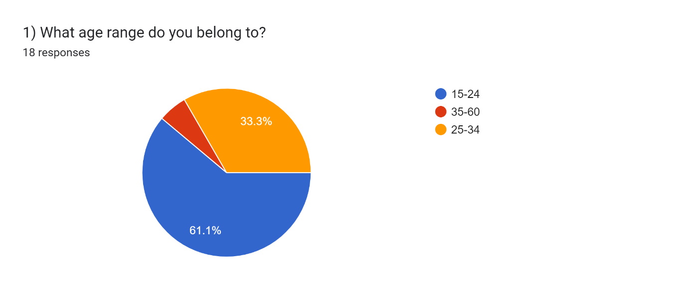
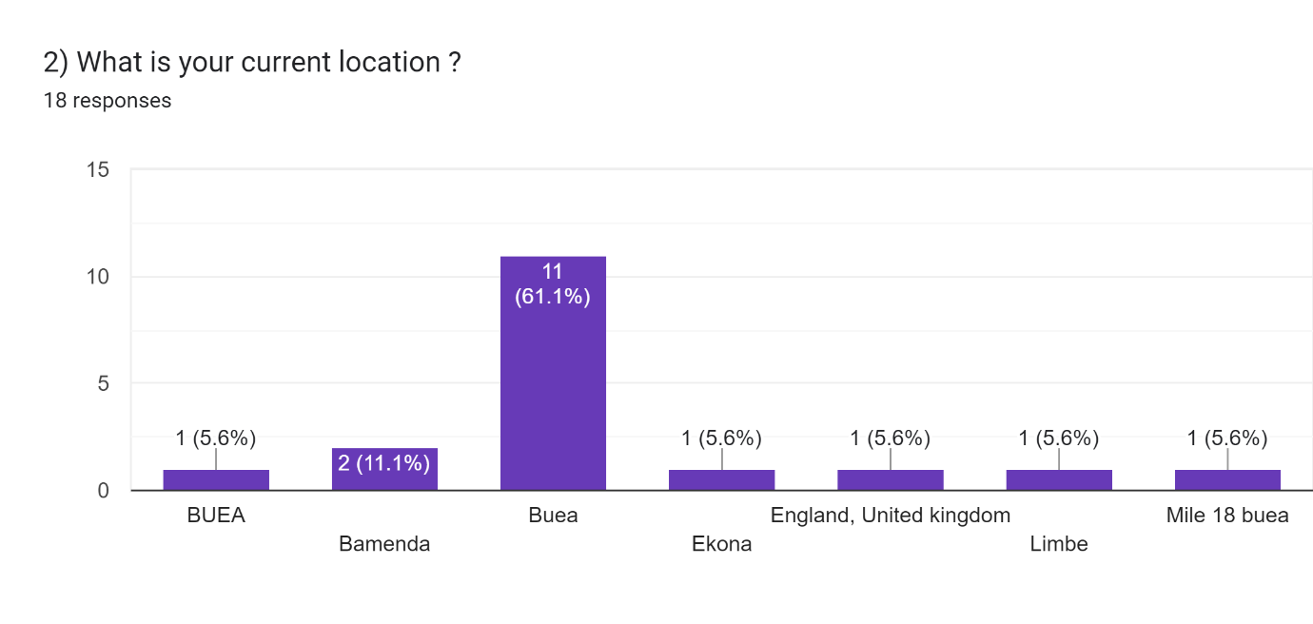
4) Requirement Gathering Analysis
Survey Form Analysis:

Slide 10
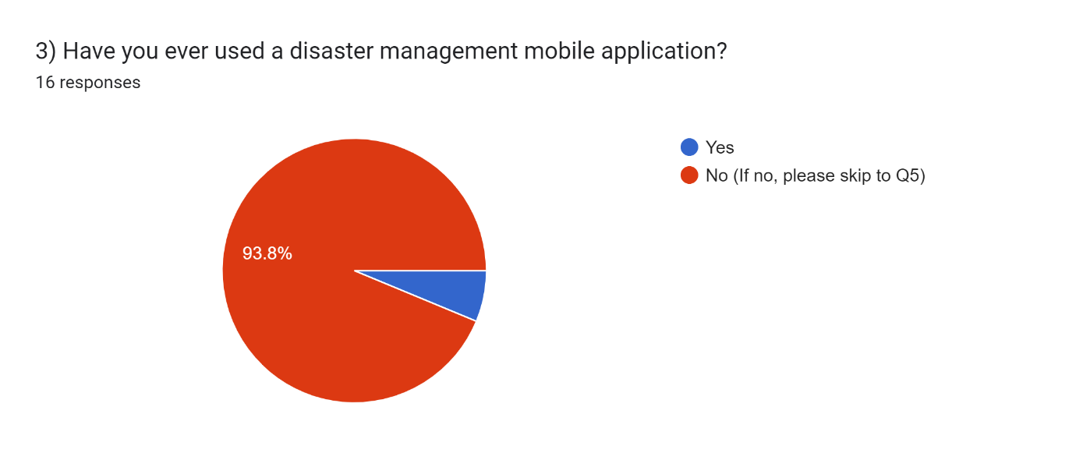
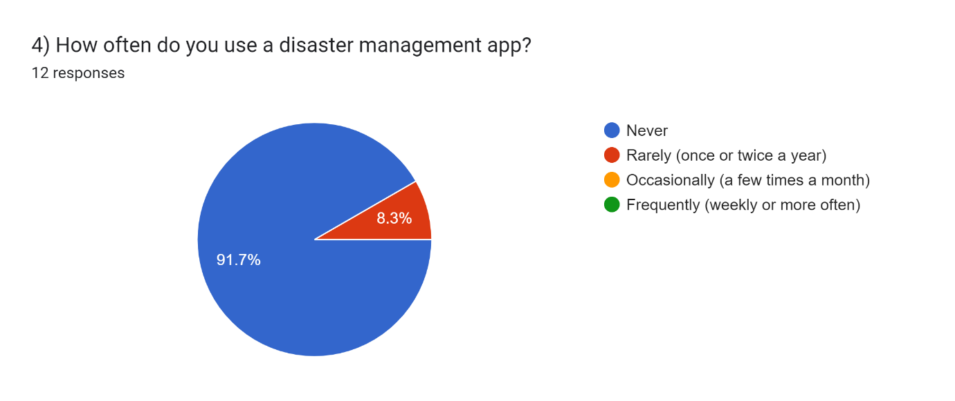
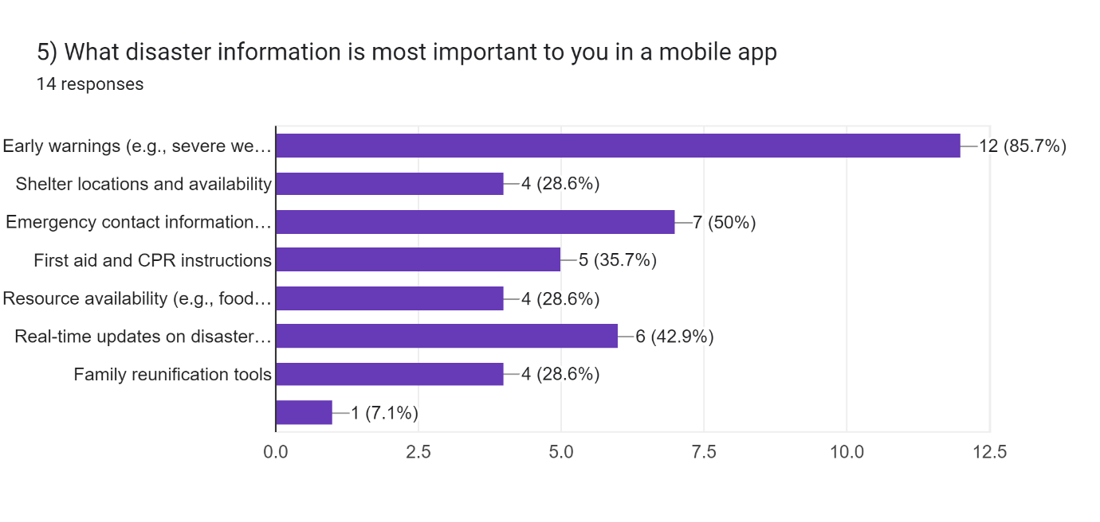
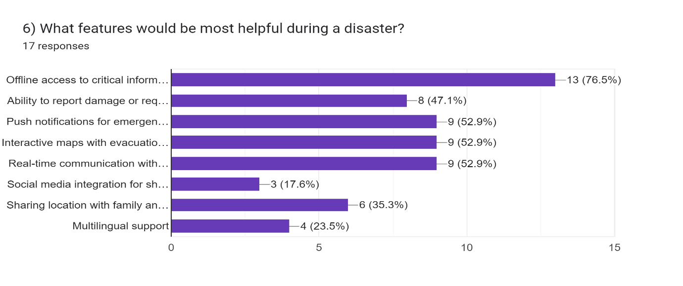

Slide 11
4) Requirement Gathering Analysis
Functional Requirements Analysis:
Strengths: Core functionalities like real-time alerts, incident reporting, and resource access empower individuals and support coordinated response efforts. Interactive maps and customizable alerts enhance user experience and situational awareness. Forums and social media integration foster community engagement and information sharing.
Weaknesses: Complexity of features might impact usability, especially for non-tech-savvy users. It's crucial to prioritize functionalities based on critical needs and conduct usability testing to ensure ease of use. Disaster-specific considerations may require additional features tailored to the prevalent types of disasters in the target region.
Non-Functional Requirements Analysis:
Strengths: Emphasis on data security, privacy, and real-time information delivery is crucial for user trust and effective response. Accessibility features like text-to-speech and larger fonts cater to users with disabilities, promoting inclusivity. Offline functionality with data synchronization ensures app usability even in areas with limited internet connectivity.
Weaknesses: Balancing performance with resource limitations on mobile devices can be challenging. Defining clear metrics for "real-time" delivery and data accuracy can be complex. Performance optimization techniques and robust server infrastructure are essential to address these challenges.

Slide 12
Conclusion
Building a disaster management mobile application requires careful consideration of technical needs, user experience, and data management principles. By leveraging tools like Figma, React Native, Node.js, and MongoDB, developers can create a robust and user-friendly application. A well-defined CAP analysis strategy helps prioritize consistency, availability, and partition tolerance based on the specific requirements of the application in a disaster scenario. This combination of technology and planning can empower individuals and communities to be better prepared, informed, and connected during emergencies, fostering a more resilient future.

Slide 13
References
1) SMS emergency broadcasting: http://www.egov4dev.org/mgovapplic.htm
2) Mobile devices to government authorities :www.jsce-int.org/Report/report/flood_euro.pdf
3)The value of GSM in a natural disaster situation: http://www.gsmworld.com/news/press_2000/press_releases_43.shtml
4) New emergency response system helps fight disasters (EGERIS) : http://www.innovations-report.com/html/reports/communication_media/report-29094.html
5)Disaster Emergency Management Information System (AFAYBIS): http://www.isprs.org/istanbul2004/comm4/papers/339.pdf

